Slide 1


// CODE . ŃAC lś . REPEAT . //

Slide 2
Learning & Training Program
TEAM LEADER: LAKSHYA GANGWAR TEAM MEMBERS:
: KRISHNA SHUKLA
: KARTIKEY PATHAK
: MAYANK PRAKASH
: LAKSHYA GANGWAR
: ANSHUMAN

Slide 3
Course Overview
▶ • Introduction to Machine Learning and
its importance
▶ • Learning objectives and expected outcomes
▶ • Prerequisites: Basic Python and Mathematics
▶ • Core machine learning concepts: data,
features, models, and algorithms
▶ • Hands-on practical exercises using real-world datasets
▶ • Final mini-project and assessment

Slide 4
Basics of Python
▶ • Python is a simple, readable, and beginner-friendly programming language.
▶ • Variables and data types: integers, floats,
strings, and booleans.
▶ • Control statements: if-else conditions, loops (for and while).
▶ • Functions help organize and reuse code
efficiently.
▶ • Libraries such as NumPy and Pandas support
data analysis and machine learning.

Slide 5


Tools
▶ Python, Jupyter Notebook, NumPy,
Pandas, Scikit-learn, Matplotlib

Slide 6

NumPy Library
NumPy provides fast, efficient multidimensional arrays.
It offers mathematical, statistical, and linear algebra functions.
NumPy is widely used for data analysis and machine learning.

Slide 7
Pandas Library
▶ • Pandas is a powerful Python library for data manipulation and analysis.
▶ • It provides Data Frame and Series data structures to organize data efficiently.
▶ • Pandas makes it easy to clean, filter, sort, and transform datasets.
▶ • It can read and write data from CSV, Excel, SQL, and many other file formats.
▶ • Pandas is widely used in data science, machine learning, and business analytics.

Slide 8
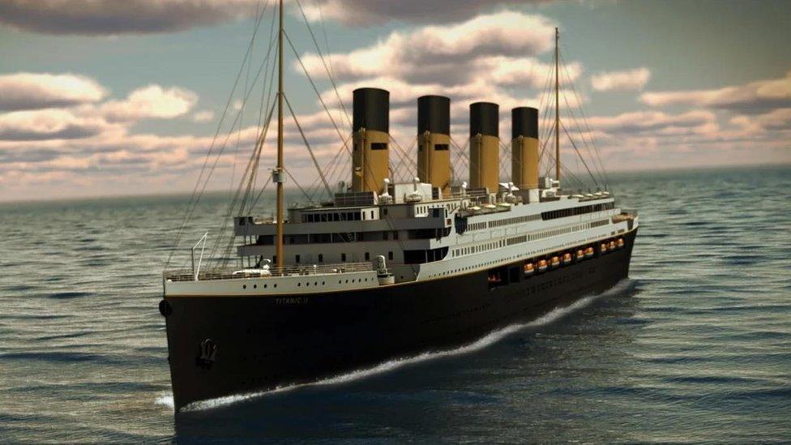
Main Topic: To Analize The Death And Survive Ratio By Python

Slide 9
KNN
▶ K-Nearest Neighbours (KNN) is a simple, non-parametric, and supervised machine learning algorithm used for both classification and regression tasks. It operates on the core principle of proximity and similarity, making predictions about a new data point based on the characteristics of the known data points closest to it.

Slide 10
How KNN Works
▶ The algorithm does not build a mathematical model during a training phase. Instead, it stores the entire dataset and performs computations only when you ask it to make a prediction.
Concepts
▶ K-Nearest Neighbors (KNN) algorithm, Titanic dataset, data preprocessing, feature selection, train-test split, model training, prediction, accuracy evaluation

Slide 11
Pros and Cons
▶ Advantages :
▶ Extremely easy to understand and implement. -No training time required.
▶ Highly versatile for multi-class data.
▶ Disadvantages :
▶ Slow and computationally expensive with large datasets, as it scans the whole database for every prediction.
▶ Requires high memory usage to store all of the training data.
▶ Suffers from the curse of dimensionality; performance drops significantly when dealing with too many features.

Slide 12
How KNN Works on the Titanic Dataset
▶ The KNN algorithm is a supervised classification method. Instead of building a complex mathematical formula, it memorizes the training data. When it sees a new passenger, it looks at the K closest, most similar passengers in the dataset. It then assigns the most common survival outcome among those neighbors to the new passenger.

Slide 13
Steps include
▶ Loading the Titanic dataset
▶ Preprocessing data (handling missing values,
encoding categorical variables)
▶ Selecting features
▶ Splitting data into training and testing sets
▶ Training the KNN model
▶ Making predictions
▶ Evaluating the model's accuracy

Slide 14
CODE FOR CNN
import numpy as np
import pandas as Pd
import matplotlib.pyplot as plt
from sklearn.model_selection import train_test_split
from sklearn.neighbors import KNeighborsClassifier
from sklearn.metrics import accuracy_score,
confusion_matrix
np.random.seed(42)
n = 891
pclass = np.random.choice([1, 2, 3], size=n, p=[0.24,
0.21, 0.55])
sex = np.random.choice(['male', 'female'], size=n,
p=[0.65, 0.35])
age = np.clip(np.random.normal(29, 14, size=n), 0.5, 80)
fare = np.where(pclass == 1, np.random.normal(84, 40, n),
np.where(pclass == 2, np.random.normal(20, 10, n),
np.random.normal(13, 8, n)))
fare = np.clip(fare, 4, 512)
# survival probability based on real Titanic patterns
base = 0.15
prob = base + (sex == 'female') * 0.55 + (pclass == 1) *
0.20 + (pclass == 2) * 0.10 + (age < 12) * 0.15
prob = np.clip(prob, 0, 1)
survived = np.random.binomial(1, prob)

Slide 15
df = pd.DataFrame({'survived': survived,
'pclass': pclass, 'sex': sex, 'age': age,
'fare': fare})
# Encode sex, split features/target
df['sex'] = df['sex'].map({'male': 0,
'female': 1})
X = df[['pclass', 'sex', 'age', 'fare’]]
y = df['survived’]
X_train, X_test, y_train, y_test =
train_test_split(X, y, test_size=0.2,
random_state=42)
# Train KNN
model =
KNeighborsClassifier(n_neighbors=5)
model.fit(X_train, y_train)
y_pred = model.predict(X_test
acc = accuracy_score(y_test, y_pred)

Slide 16
plt.subplots(1, 2, figsize=(11, 4.5))
# 1) Survival rate by sex and class
surv_rate = df.groupby(['pclass',
'sex'])['survived'].mean().unstack()
surv_rate.columns = ['Male', 'Female']
surv_rate.plot(kind='bar', ax=axes[0], color=['#4C72B0', '#DD8452’])
axes[0].set_title('Survival Rate by Class & Sex’)
axes[0].set_xlabel('Passenger Class’)
axes[0].set_ylabel('Survival Rate’)
axes[0].set_xticklabels([1, 2, 3], rotation=0)
axes[0].legend(title='Sex’)
# 2) Confusion matrix for the KNN model
cm = confusion_matrix(y_test, y_pred)
im = axes[1].imshow(cm, cmap='Blues')
axes[1].set_title(f'KNN Confusion Matrix (Acc={acc:.2f})')
axes[1].set_xlabel('Predicted')
axes[1].set_ylabel('Actual')
axes[1].set_xticks([0, 1]); axes[1].set_xticklabels(['Died',
'Survived'])
axes[1].set_yticks([0, 1]); axes[1].set_yticklabels(['Died',
'Survived'])
for i in range(2):
for j in range(2):
axes[1].text(j, i, cm[i, j], ha='center', va='center',
color='black')
plt.tight_layout()
plt.savefig('/content/titanic_knn_graph.png', dpi=150)
print("Saved graph to titanic_knn_graph.png")

Slide 17
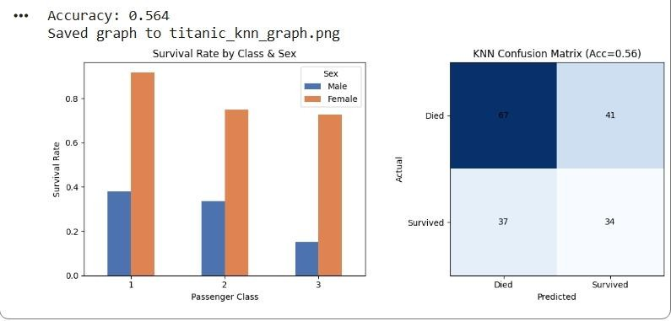
OUTPUT OF THE CODE :

Slide 18
CODE FOR LOGISTIC REGRATION
# Logistic Regression on Titanic Dataset
import pandas as pd
from sklearn.model_selection import train_test_split
from sklearn.linear_model import LogisticRegression
from sklearn.metrics import accuracy_score, classification_report,
confusion_matrix
from sklearn.impute import SimpleImputer
# Load CSV file
df = pd.read_csv("titanic.csv")
# Display first 5 rows
print("First 5 Rows:")
print(df.head())
# Select features and target
features = ['Pclass', 'Sex', 'Age', 'SibSp', 'Parch', 'Fare']
target = 'Survived'
X = df[features]
y = df[target]

Slide 19
LOGISTIC REGRATION
▶ Logistic regression is used because the target variable is binary—
there are only two possible outcomes.
▶ In the Titanic dataset, the target is:
▶ 1 = Survived
▶ 0 = Did not survive
▶ Logistic regression is designed specifically for this kind of classification problem.
▶
▶
Why use logistic regression?
Predicts probabilities
▶ Instead of just saying "survived" or "did not survive," it estimates the
probability of survival.
▶ Example:
▶ Passenger A: 92% chance of survival
▶ Passenger B: 18% chance of survival
▶
Works well for binary outcomes
▶ Since there are only two classes (0 and 1), logistic regression is a natural choice.

Slide 20
Easy to interpret
The model shows how each feature affects the probability of survival.
For example:
Being female may increase the predicted probability.
Being in first class may increase the predicted probability.
Being in third class may decrease the predicted probability.
Fast and efficient
It trains quickly, even on larger datasets, and is often used as a strong baseline model.
Produces clear decisions
If the predicted probability is greater than a chosen threshold (commonly 0.5), the model predicts Survived (1).
Otherwise, it predicts Did not survive (0).
Why not use linear regression?
Linear regression predicts any real number, so it could produce impossible values like:
1.4 (greater than 1)
−0.3 (less than 0)
These cannot represent valid probabilities.
Logistic regression, by using the sigmoid function, always outputs values between 0 and 1, making it suitable for predicting probabilities and binary outcomes.

Slide 21
# Convert categorical column into numeric
X['Sex'] = X['Sex'].map({'male': 0, 'female': 1})
# Fill missing values
imputer = SimpleImputer(strategy='mean')
X = imputer.fit_transform(X)
# Split data into training and testing sets
X_train, X_test, y_train, y_test =
train_test_split(
X, y, test_size=0.2, random_state=42
)
# Create Logistic Regression model
model = LogisticRegression(max_iter=1000)
# Train model
model.fit(X_train, y_train)
# Predict on test data
y_pred = model.predict(X_test)
# Model Evaluation
print("\nAccuracy:", accuracy_score(y_test, y_pred))

Slide 22
print("\nConfusion Matrix:")
print(confusion_matrix(y_test, y_pred))
print("\nClassification Report:")
print(classification_report(y_test,
y_pred))
# Predict a new passenger
new_passenger = [[3, 0, 22, 1, 0, 7.25]]
# Pclass, Sex, Age, SibSp, Parch, Fare
prediction = model.predict(new_passenger)
if prediction[0] == 1:
print("\nPrediction: Passenger
Survived")
else:
print("\nPrediction: Passenger Did Not
Survive")

Slide 23
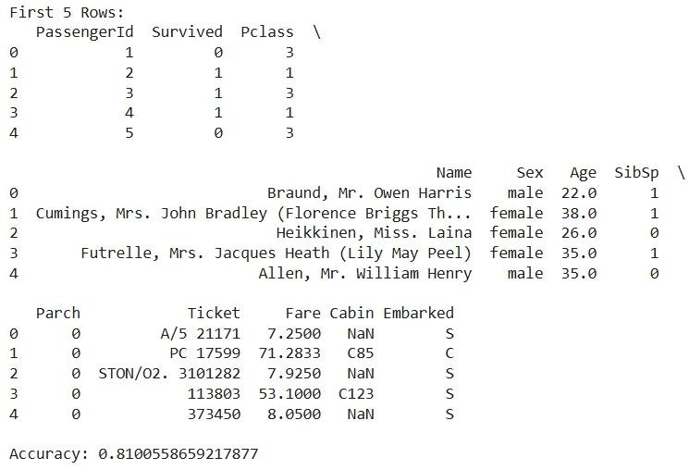
OUTPUT OF THE CODE

Slide 24
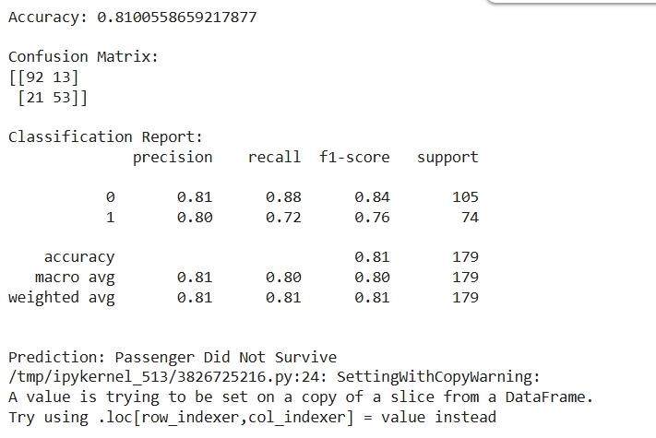
OUTPUT OF THE CODE :

Slide 25


CONCLUSION
Using your uploaded Titanic dataset, I compared Logistic Regression and K-Nearest Neighbors (KNN) using an 80/20 train-test split. Missing values were imputed, categorical variables were one-hot encoded, and numerical features were standardized before training.
Model Comparison
Metric | Logistic Regression | KNN (k = 5)
Accuracy | 80.45% | 81.56%
Precision | 79.31% | 80.00%
Recall | 66.67% | 69.57%
F1-Score | 72.44% | 74.42%
For this Titanic dataset:
Best Accuracy: KNN (81.56%)
Most Interpretable Model: Logistic Regression
Recommendation: Although KNN performs marginally better, Logistic Regression remains an excellent baseline because it is simpler, faster, and easier to explain.

